Slide 1
Federated Login CSRF
Murali Vadakke Puthanveetil
Microsoft

Slide 2

Bio
Senior security engineer at Windows Services PenTest team at Microsoft.
Interests: web applications, Authentication/Authorization protocols

Slide 3
Agenda
Quick Recap of key concepts
Scenario
OAuth CSRF
OpenID Connect Login CSRF
Federated Login CSRF
Demo and sample code
Mitigations

Slide 4
Quick Recap – Federated Login
Cloud Boundary
2. Transforms
Trusts
3. Get Token
Trusts
Corporate Boundary
3. Access service
using
transformed token
1. Get Token

Slide 5
Quick Recap – Login CSRF
2. Loads JavaScript
3. Posts Attacker’s Username and Password
1. Clicks on malicious Link
4. Sets Attacker’s Session Cookie
Reference: A. Barth, C. Jackson and J. C. Mitchell, "Robust defenses for cross-site request forgery," in Proceedings of the 15th ACM conference on Computer and communications security , 2008

Slide 6


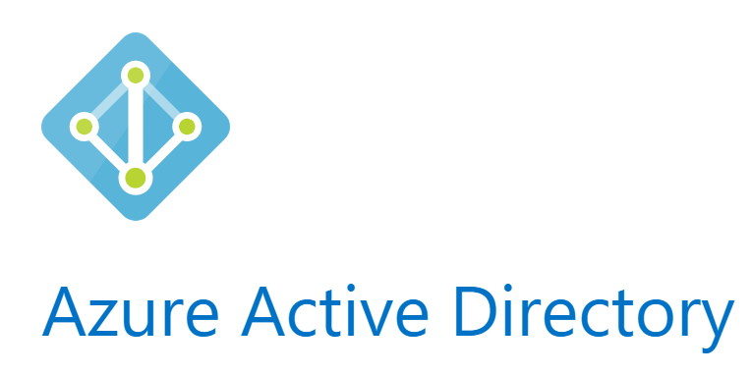









Different Identities
Work Identities
Personal Identities
and many more…
and many more…

Slide 7
Scenario

Slide 8
Additional CSRF Scenarios
OAuth State Validation
Login CSRF in OpenID Connect

Slide 9
OAuth Code Grant Flow
10. Make Requests with Access Token
2. Request Connect
Social Profile
3. Initiate OAuth Consent
7. 302 Redirect with
AuthCode
9. Access/Refresh Tokens-
Links Current Session With these tokens
8. AuthCode, ClientID, Client Secret
1. Initiate Connect
Social Profile
5. Authorization
Request
4. Provide Consent
to access social profile
6. AuthCode

Slide 10
Known CSRF Risk in OAuth
Attacker follows steps 1 to 6 to get an AuthCode for Attacker’s Social Profile
2. Request Connect
Social Profile
3. Initiate OAuth Consent
1. Initiate Connect
Social Profile
5. Authorization
Request
4. Provide Consent
to access social profile
6. AuthCode

Slide 11
Known CSRF Risk in OAuth
6. Make Requests with
Attacker’s Access Token
1. Email’s a link with Attacker’s AuthCode
3. 302 Redirect with
Attacker’s AuthCode
5. Access/Refresh Tokens-
Links Current Session With these tokens
4. AuthCode, ClientID, Client Secret
2. Click’s On Link

Slide 12
Recommended State parameter
“state – RECOMMENDED. An opaque value used by the client to maintain state between the request and callback. The authorization server includes this value when redirecting the user-agent back to the client. The parameter SHOULD be used for preventing cross-site request forgery as described in Section 10.12.”
The mitigation for this attack scenario is to ALWAYS implement this RECOMMENDED parameter
Reference: https://tools.ietf.org/html/rfc6749

Slide 13
OpenID connect login flow
2. Navigate to Business App
3. 401 Unauthorized
7. 302 Redirect to redirectURL
with IDToken
7. Business App verifies IDToken
and creates a session cookie
4. 302 Redirect with ClientID and registered redirect URL
6. ID Token
1. Access Business App
5. Login with user credentials

Slide 14
Known CSRF Risk in OpenID Connect
Attacker follows steps 1 to 6 to get Attacker’s Own IDToken
2. Navigate to Business App
3. 401 Unauthorized
4. 302 Redirect with ClientID and registered redirect URL
6. ID Token
1. Access Business App
5. Login with user credentials

Slide 15
Known CSRF Risk in OpenID Connect
Impact
Attacker’s Business App session is established on Victim’s Browser
1. Email’s a link with Attacker’s ID Token
3. 302 Redirect with
Attacker’s IDToken
4. Business App verifies ID Token and creates a Session cookie for Attacker in Victim’s Browser
2. Click’s On Link

Slide 16
Risk in the current scenario
Initiate link to social profile
Initiate OAuth Consent (clientID=BA, STATE)
302 Redirect with Victim’s AuthCode, STATE
Access/Refresh Tokens-
Links Current Session With these tokens
AuthCode, ClientID, Client Secret
After validating STATE
Consent may be automatic if user had consented to clientID=BA earlier
Cookies:
Business Application: AttackerID
Social Profile: VictimID
Authcode for Victim’s identity

Slide 17
Recommended Parameter from OpenID Connect Spec
“State - RECOMMENDED. Opaque value used to maintain state between the request and the callback. Typically, Cross-Site Request Forgery (CSRF, XSRF) mitigation is done by cryptographically binding the value of this parameter with a browser cookie.”
The mitigation for this attack scenario is to ALWAYS implement this RECOMMENDED parameter
Reference: http://openid.net/specs/openid-connect-core-1_0-final.html

Slide 18
Federated Login CSRF (Pre-Conditions)
Business App uses a federated Identity provider
Business App is a multi-tenant application, where multiple federated identity providers can be used
Business App has an OAuth configuration for accessing external resource providers

Slide 19
Attacker configuration

Slide 20
Attack data flow sequence
Victim
Victim’s Browser
Attacker Website
Attacker Identity Provider
Business Application
Online Federated Identity Provider
Navigates to Attacker site
Clicks on malicious
link
Navigates to Business Application
Sets OpenID Connect STATE cookie before redirecting to Online Federated IdP
Redirects to Online Federated IdP
Sets Online IdP’s STATE Cookie
Redirects to Attacker’s IdP
Attacker’s IdP auto-login as attacker
and redirect to Online IDP
Verifies STATE
Redirects to Business App with Attacker ID Token
Verifies STATE
Sets Attacker’s Business App session cookie

Slide 21
Risks
Even if the BusinessApp implements the correct State parameter specified in OpenID Connect, an attacker may still be able to hijack a victim’s browser to create an attacker login session for Business App using federation
The impact of such a CSRF in the current scenario is, the OAuth flow may link this BusinessApp session to victim’s external resource

Slide 22
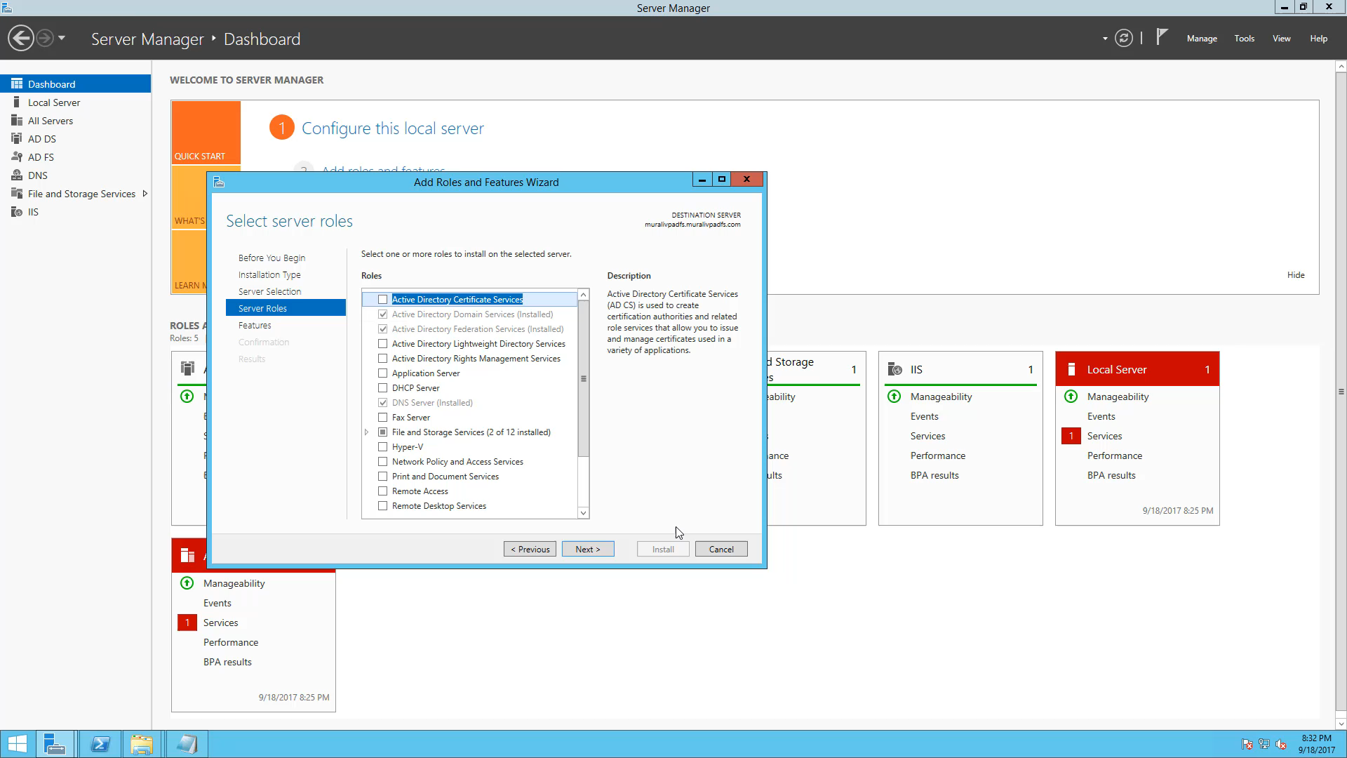
Demo

Slide 23
Sample script for auto-logon
https://github.com/muralivp/Auto-Signin-script-for-ADFS

Slide 24
ADFS can be federated with…
Azure
https://docs.microsoft.com/en-us/azure/active-directory/connect/active-directory-aadconnectfed-whatis
AWS
https://aws.amazon.com/blogs/security/enabling-federation-to-aws-using-windows-active-directory-adfs-and-saml-2-0/
Salesforce
https://developer.salesforce.com/page/Single_Sign-On_with_Force.com_and_Microsoft_Active_Directory_Federation_Services
Facebook Workplace
https://developers.facebook.com/docs/workplace/authentication/sso/#adfs

Slide 25
Mitigation 1: Show a 2nd Consent dialog before linking identities
Show a 2nd consent page on the Business Application itself before linking the OAuth identity (refresh/access tokens) with the logged in user’s context in the Business App
“Do you want to allow Social Profile (Social user) to be linked with Business user (Business user id/name)?”

Slide 26
Mitigation 2: Use separate ClientIDs per tenant
Show a 2nd consent page on the Business Application itself before linking the OAuth identity (refresh/access tokens) with the logged in user’s context in the Business App
This would prevent automatic consent, if each client ID uniquely identifies the tenant in Business Application, the user can make an informed decision

Slide 27
Mitigation 3: “Always prompt” for OAuth consent
Some social identity providers allow an “Always Prompt” mode for Oauth consent. This means there will never be automatic consent to get an AuthCode
Residual risk: The user may not be aware that Business App asking for consent is in Attacker’s session and may consent anyway

Slide 28
Conclusions
Always review any implementation that tries to link 2 different identities
Ensure state validations are implemented correctly
Consider implementing an additional user consent dialog for each implementation that needs to link identities

Slide 29
Questions?

Slide 30
Thank You!

